Slide 1


CS 153: Concepts of Compiler Design September 1 Class Meeting
Department of Computer Science San Jose State University Fall 2020 Instructor: Ron Mak
www.cs.sjsu.edu/~mak

Slide 2
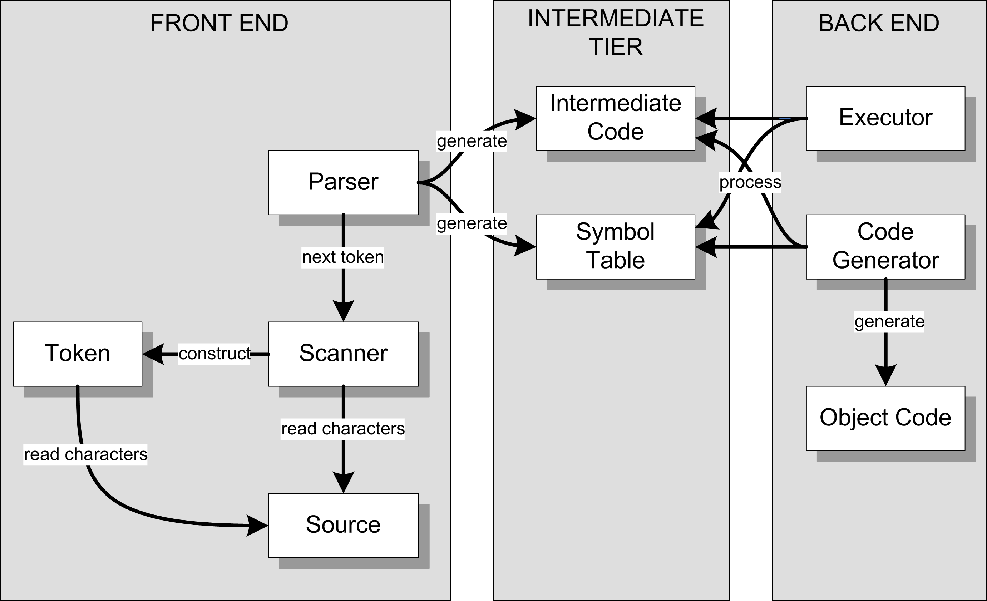
Review: Conceptual Design
Interpreter
Compiler or
converter

Slide 3
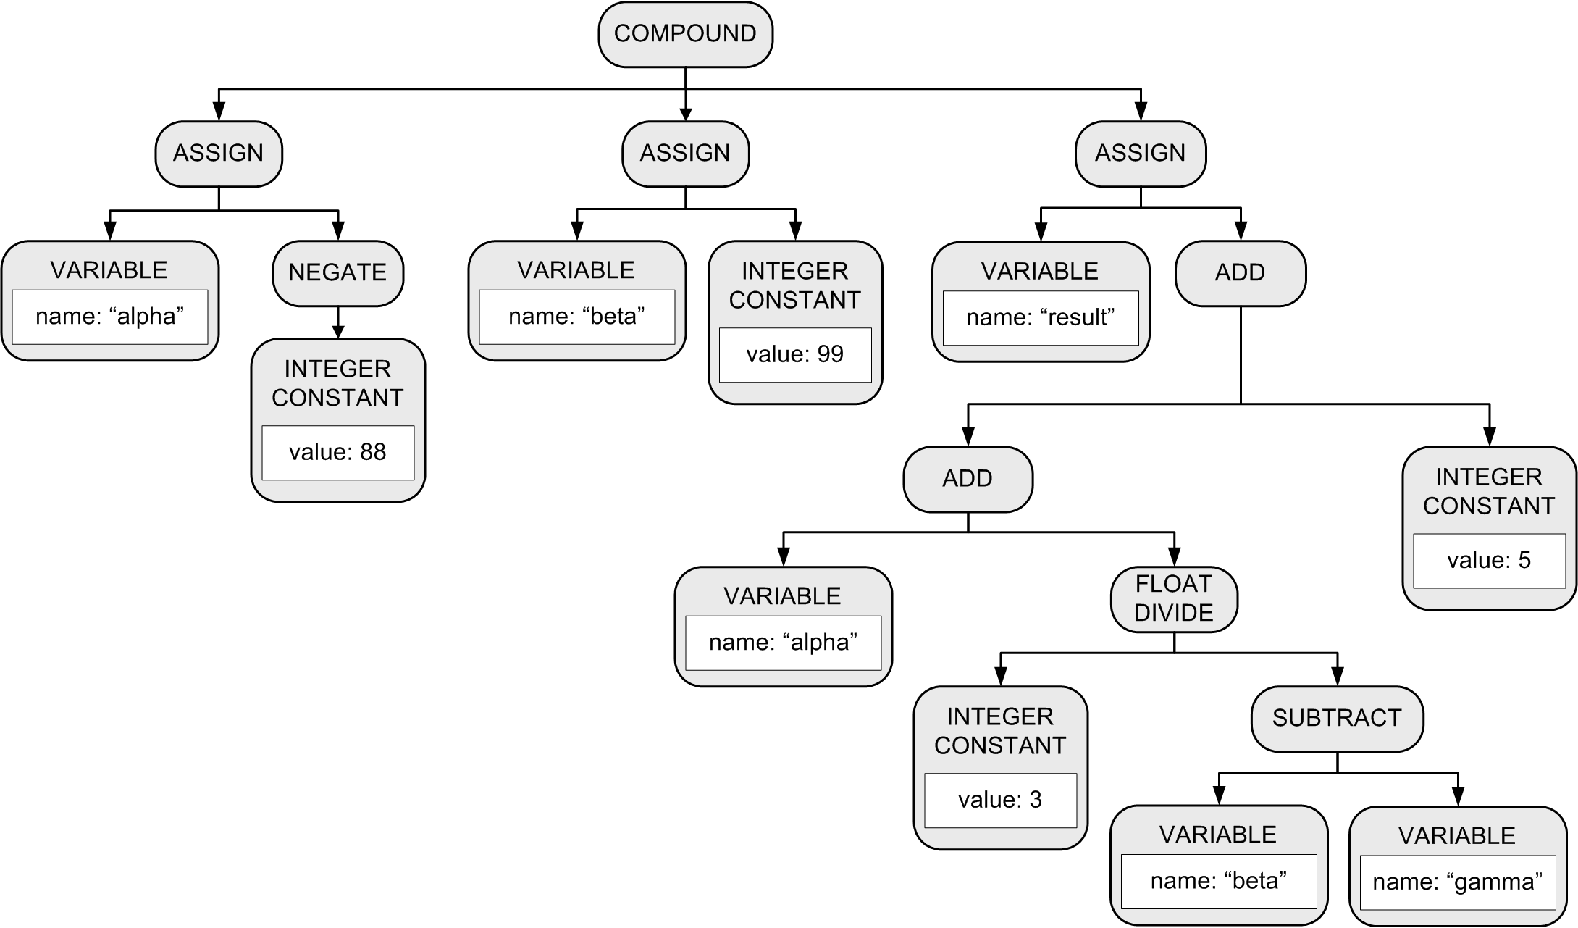
Parse Tree: Conceptual Design
More accurately called an
abstract syntax tree (AST).
BEGIN
alpha := -88;
beta := 99;
result := alpha + 3/(beta – gamma) + 5
END

Slide 4

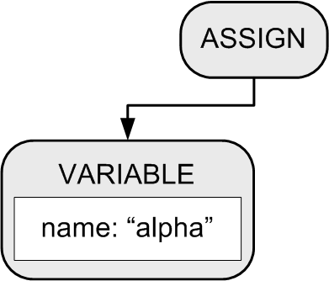
Building a Parse Tree
Example:
BEGIN
alpha := 10;
beta := 20
END
Function parseCompoundStatement() method creates a COMPOUND node.
2. Function parseAssignmentStatement() creates an ASSIGN node and a VARIABLE node, which the ASSIGN node adopts as its first child.

Slide 5
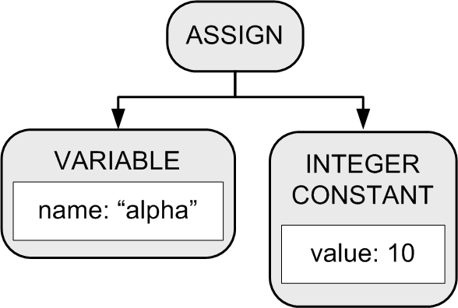
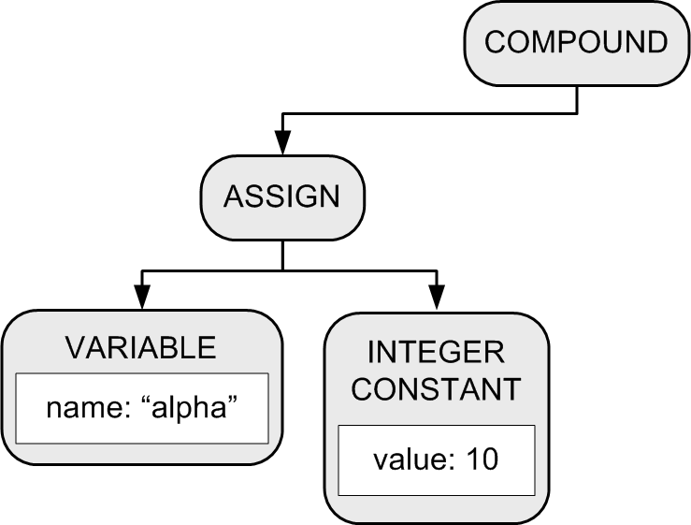
Building a Parse Tree
3. Function parseExpression() creates an INTEGER CONSTANT node which the ASSIGN node adopts as its second child.
BEGIN
alpha := 10;
beta := 20
END
4. The COMPOUND node adopts the ASSIGN node as its first child.

Slide 6
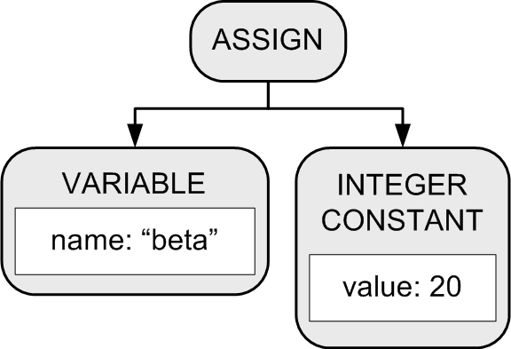
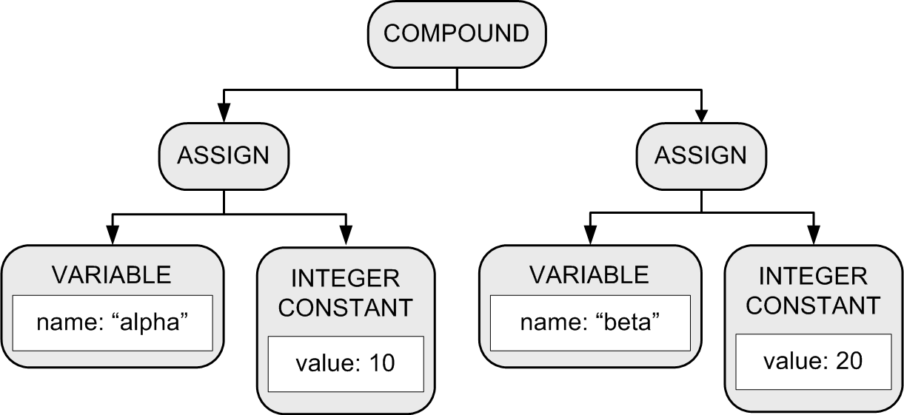
Building a Parse Tree
Another set of calls to functions parseAssignmentStatement() and parsExpression() builds another assignment statement subtree.
6. The COMPOUND node
adopts the subtree
as its second child.
BEGIN
alpha := 10;
beta := 20
END

Slide 7
Example: HelloWorld.txt
PROGRAM HelloWorld;
BEGIN
i := 0;
REPEAT
i := i + 1;
write('#'); write(i);
writeln(': Hello, world!');
UNTIL i = 5;
END.
<PROGRAM HelloWorld>
<COMPOUND line 3>
<ASSIGN line 4>
<VARIABLE i />
<INTEGER_CONSTANT 0 />
</ASSIGN>
<LOOP line 6>
<ASSIGN line 7>
<VARIABLE i />
<ADD>
<VARIABLE i />
<INTEGER_CONSTANT 1 />
</ADD>
</ASSIGN>
<WRITE line 8>
<STRING_CONSTANT '#' />
</WRITE>
<WRITE line 8>
<VARIABLE i />
</WRITE>
<WRITELN line 9>
<STRING_CONSTANT ': Hello, world!' />
</WRITELN>
<TEST line 10>
<EQ>
<VARIABLE i />
<INTEGER_CONSTANT 5 />
</EQ>
</TEST>
</LOOP>
</COMPOUND>
</PROGRAM>
PROGRAM
COMPOUND
ASSIGN
LOOP
ASSIGN
WRITE
WRITE
WRITELN
TEST

Slide 8
The parseProgram() Method
Parser.java
public Node parseProgram()
{
Node programNode = new Node(Node.NodeType.PROGRAM);
currentToken = scanner.nextToken(); // first token!
if (currentToken.type == Token.TokenType.PROGRAM)
{
currentToken = scanner.nextToken(); // consume PROGRAM
}
else syntaxError("Expecting PROGRAM");
if (currentToken.type == IDENTIFIER)
{
String programName = currentToken.text;
symtab.enter(programName);
programNode.text = programName;
currentToken = scanner.nextToken(); // consume program name
}
else syntaxError("Expecting program name");
package frontend

Slide 9
The parseProgram() Method, cont’d
Parser.java
if (currentToken.type == SEMICOLON)
{
currentToken = scanner.nextToken(); // consume ;
}
else syntaxError("Missing ;");
if (currentToken.type != BEGIN) syntaxError("Expecting BEGIN");
// The PROGRAM node adopts the COMPOUND tree.
programNode.adopt(parseCompoundStatement());
if (currentToken.type != PERIOD) syntaxError("Expecting .");
return programNode;
}
PROGRAM
COMPOUND
ASSIGN
LOOP
ASSIGN
WRITE
WRITE
WRITELN
TEST

Slide 10
The parseCompoundStatement() Method
Parser.java
private Node parseCompoundStatement()
{
Node compoundNode = new Node(COMPOUND);
compoundNode.lineNumber = currentToken.lineNumber;
currentToken = scanner.nextToken(); // consume BEGIN
parseStatementList(compoundNode, END);
if (currentToken.type == END)
{
currentToken = scanner.nextToken(); // consume END
}
else syntaxError("Expecting END");
return compoundNode;
}
PROGRAM
COMPOUND
ASSIGN
LOOP
ASSIGN
WRITE
WRITE
WRITELN
TEST

Slide 11
The parseStatementList() Method
private void parseStatementList(Node parentNode, Token.TokenType terminalType)
{
while ( (currentToken.type != terminalType)
&& (currentToken.type != END_OF_FILE))
{
Node stmtNode = parseStatement();
if (stmtNode != null) parentNode.adopt(stmtNode);
// A semicolon separates statements.
if (currentToken.type == SEMICOLON)
{
while (currentToken.type == SEMICOLON)
{
currentToken = scanner.nextToken(); // consume ;
}
}
else if (statementStarters.contains(currentToken.type))
{
syntaxError("Missing ;");
}
}
}
Do we see the start of the next statement
without having seen a semicolon?
Parser.java

Slide 12
Statement Starter Tokens
private static HashSet<Token.TokenType> statementStarters;
...
static
{
statementStarters = new HashSet<Token.TokenType>();
...
// Tokens that can start a statement.
statementStarters.add(BEGIN);
statementStarters.add(IDENTIFIER);
statementStarters.add(REPEAT);
statementStarters.add(Token.TokenType.WRITE);
statementStarters.add(Token.TokenType.WRITELN);
...
}
Parser.java

Slide 13
The parseStatement() Method
Parser.java
private Node parseStatement()
{
Node stmtNode = null;
int savedLineNumber = currentToken.lineNumber;
lineNumber = savedLineNumber;
switch (currentToken.type)
{
case IDENTIFIER : stmtNode = parseAssignmentStatement(); break;
case BEGIN : stmtNode = parseCompoundStatement(); break;
case REPEAT : stmtNode = parseRepeatStatement(); break;
case WRITE : stmtNode = parseWriteStatement(); break;
case WRITELN : stmtNode = parseWritelnStatement(); break;
case SEMICOLON : stmtNode = null; break; // empty statement
default : syntaxError("Unexpected token");
}
if (stmtNode != null) stmtNode.lineNumber = savedLineNumber;
return stmtNode;
}

Slide 14
The Symbol Table: Basic Concepts
Purpose
To store information about certain tokens during the translation process (i.e., parsing and scanning)
What information to store?
Anything that’s useful!
For an identifier:
name
data type
kind (variable name, type name, function name, etc.)

Slide 15
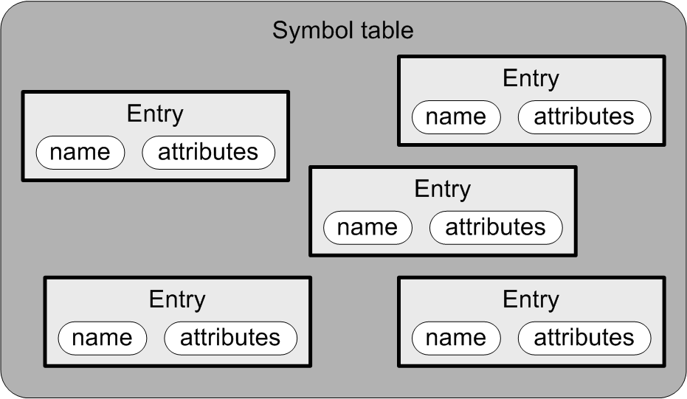
The Symbol Table: Conceptual Design
Goal: The symbol table
should be source language
independent.
Each entry in the symbol table has
a name
attributes

Slide 16
The Symbol Table: Basic Operations
Enter new information.
Look up existing information.
Update existing information.
The parser performs these operations whenever it gets an identifier token from the scanner.

Slide 17
What Needs a Symbol Table?
A Pascal program
Identifiers for constant, type, variable, procedure, and function names.
A Pascal procedure or function
Identifiers for constant, type, variable, procedure, and function names.
Identifiers for formal parameter names.
A Pascal record type
Identifiers for field names.

Slide 18
Symbol Table Entries
SymtabEntry.java
public class SymtabEntry
{
private String name;
private Double value;
public SymtabEntry(String name)
{
this.name = name;
this.value = 0.0;
}
public String getName() { return name; }
public Double getValue() { return value; }
public void setValue(Double value) { this.value = value; }
}
For now, we’ll store all numeric values
as datatype Double.
package intermediate

Slide 19
The Symbol Table
Symtab.java
public class Symtab
{
private HashMap<String, SymtabEntry> contents = new HashMap<>();
public SymtabEntry enter(String name)
{
SymtabEntry entry = new SymtabEntry(name);
contents.put(name, entry);
return entry;
}
public SymtabEntry lookup(String name) { return contents.get(name); }
}
Return null if the name is not
contained in the HashMap.
package intermediate

Slide 20
A Hack!
So far, we haven’t parsed any variable declarations.
The hack:
When a variable appears on the left-hand-side of an assignment statement (i.e., it’s the target of the assignment) and it’s not already in the symbol table, enter it into the symbol table.
When a variable appears in an expression, check to see if it’s in the symbol table.
The variable is undeclared if it isn’t in the symbol table.

Slide 21
The parseAssignmentStatement() Method
Parser.java
private Node parseAssignmentStatement()
{
// The current token should now be the left-hand-side variable name.
Node assignmentNode = new Node(ASSIGN);
// Enter the variable name into the symbol table
// if it isn't already in there.
String variableName = currentToken.text;
SymtabEntry variableId = symtab.lookup(variableName.toLowerCase());
if (variableId == null) variableId = symtab.enter(variableName);
// The assignment node adopts the variable node as its first child.
Node lhsNode = new Node(VARIABLE);
lhsNode.text = variableName;
lhsNode.entry = variableId;
assignmentNode.adopt(lhsNode);
currentToken = scanner.nextToken(); // consume the LHS variable;
package frontend

Slide 22
parseAssignmentStatement(), cont’d
Parser.java
if (currentToken.type == COLON_EQUALS)
{
currentToken = scanner.nextToken(); // consume :=
}
else syntaxError("Missing :=");
// The assignment node adopts the expression node as its second child.
Node rhsNode = parseExpression();
assignmentNode.adopt(rhsNode);
return assignmentNode;
}

Slide 23
The parseFactor() Method
private Node parseFactor()
{
// The current token should now be an identifier or a number or (
if (currentToken.type == IDENTIFIER) return parseVariable();
else if (currentToken.type == INTEGER) return parseIntegerConstant();
else if (currentToken.type == REAL) return parseRealConstant();
else if (currentToken.type == LPAREN)
{
currentToken = scanner.nextToken(); // consume (
Node exprNode = parseExpression();
if (currentToken.type == RPAREN)
{
currentToken = scanner.nextToken(); // consume )
}
else syntaxError("Expecting )");
return exprNode;
}
else syntaxError("Unexpected token");
return null;
}
Parser.java

Slide 24
The parseVariable() Method
Parser.java
private Node parseVariable()
{
// The current token should now be an identifier.
// Has the variable been "declared"?
String variableName = currentToken.text;
SymtabEntry variableId = symtab.lookup(variableName.toLowerCase());
if (variableId == null) semanticError("Undeclared identifier");
Node node = new Node(VARIABLE);
node.text = variableName;
currentToken = scanner.nextToken(); // consume the identifier
return node;
}

Slide 25
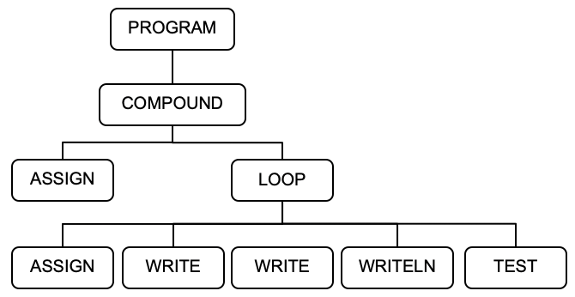
The parseRepeatStatement() Method
private Node parseRepeatStatement()
{
// The current token should now be REPEAT.
// Create a LOOP node.
Node loopNode = new Node(LOOP);
currentToken = scanner.nextToken(); // consume REPEAT
parseStatementList(loopNode, UNTIL);
if (currentToken.type == UNTIL)
{
// Create a TEST node. It adopts the test expression node.
Node testNode = new Node(TEST);
lineNumber = currentToken.lineNumber;
testNode.lineNumber = lineNumber;
currentToken = scanner.nextToken(); // consume UNTIL
testNode.adopt(parseExpression());
// The LOOP node adopts the TEST node as its final child.
loopNode.adopt(testNode);
}
else syntaxError("Expecting UNTIL");
return loopNode;
}
Parser.java
Demo

Slide 26
Simple Interpreter
Now that we have a basic parse tree and a rudimentary symbol table, we can start the backend tier.
Recall the the backend components only work with the intermediate tier components.

Slide 27
Review: Conceptual Design
Interpreter
Compiler or
converter
Can an interpreter’s backend executor
run a Pascal program using only
the parse tree and the symbol table?

